Slide 1

Hotline Volunteers
Notes:
Thank you so much for your interest in volunteering with the Election Protection Hotline, run by the Lawyers’ Committee for Civil Rights Under the Law.

Slide 2
Hotline Overview
The EP Hotline (866-OUR-VOTE) is the largest national, nonpartisan voter help line in the country.
Volunteers are legal professionals from across the country, including law students, associates, partners, paralegals, and retired attorneys.
Hundreds of thousands of voters have been helped by the hotline over the last 20 years. Calls to the hotline have led to successful litigation expanding the right to vote and sanctions against those seeking to spread disinformation and disenfranchise voters of color.

Slide 3
Two Ways to Volunteer
Hotline Volunteer
Provides direct support to voters/callers
3 total shifts (13.5 hours) required
2 shifts must be scheduled by October 15 or your Election Day reservation will be cancelled
Choose 1 shift on Election Eve (Nov 2) or Election Day (Nov 3)
Hotline Captain
Highly trained leadership position (minimum of 25-30 hours)
Provides direct support to hotline volunteers. Reports trends and major issues to hotline staff.
This role ensures we are able surge our hotline to meet high voter demand.
Email epcaptain@lawyerscommittee.org to express interest
Notes:
The goal of this training is to give you the information you need to have a successful hotline shift helping voters. After completing this training, you will have knowledge of hotline operations, the tools used, how to interact with voters and others in the hotline space, where to find answers, how to log information, and how to get help.

Slide 4
Training Objectives
On Demand Hotline Training (1 hour) will cover:
Hotline operations
How to use the tools and platforms utilized by hotline volunteers
How to interact with voters and others on the platforms
Where and how to find answers
How to log information into the EP database
How to get help from captains and staff
Notes:
The goal of this training is to give you the information you need to have a successful hotline shift helping voters. After completing this training, you will have knowledge of hotline operations, the tools used, how to interact with voters and others in the hotline space, where to find answers, how to log information, and how to get help.

Slide 5
Support Provided
We provide multiple resources on an intranet site with answers to common questions, links to useful sites, and other guidance documents.
Experienced volunteer leaders and hotline staff are always available to help.
You will be assigned a chat room where you can ask questions and receive support from hotline leaders. Each chat room has a designated volunteer captain to answer questions, monitor your work, and give advice and feedback.
If you have technical issues, there is a technical support chat room or you can email for staff assistance.

Slide 6
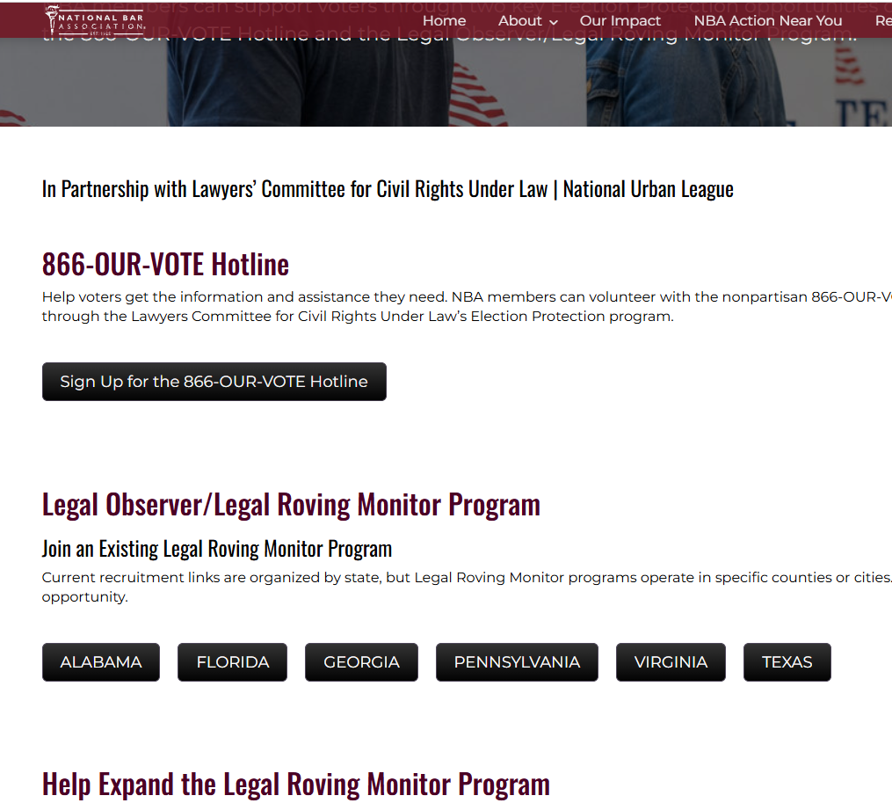
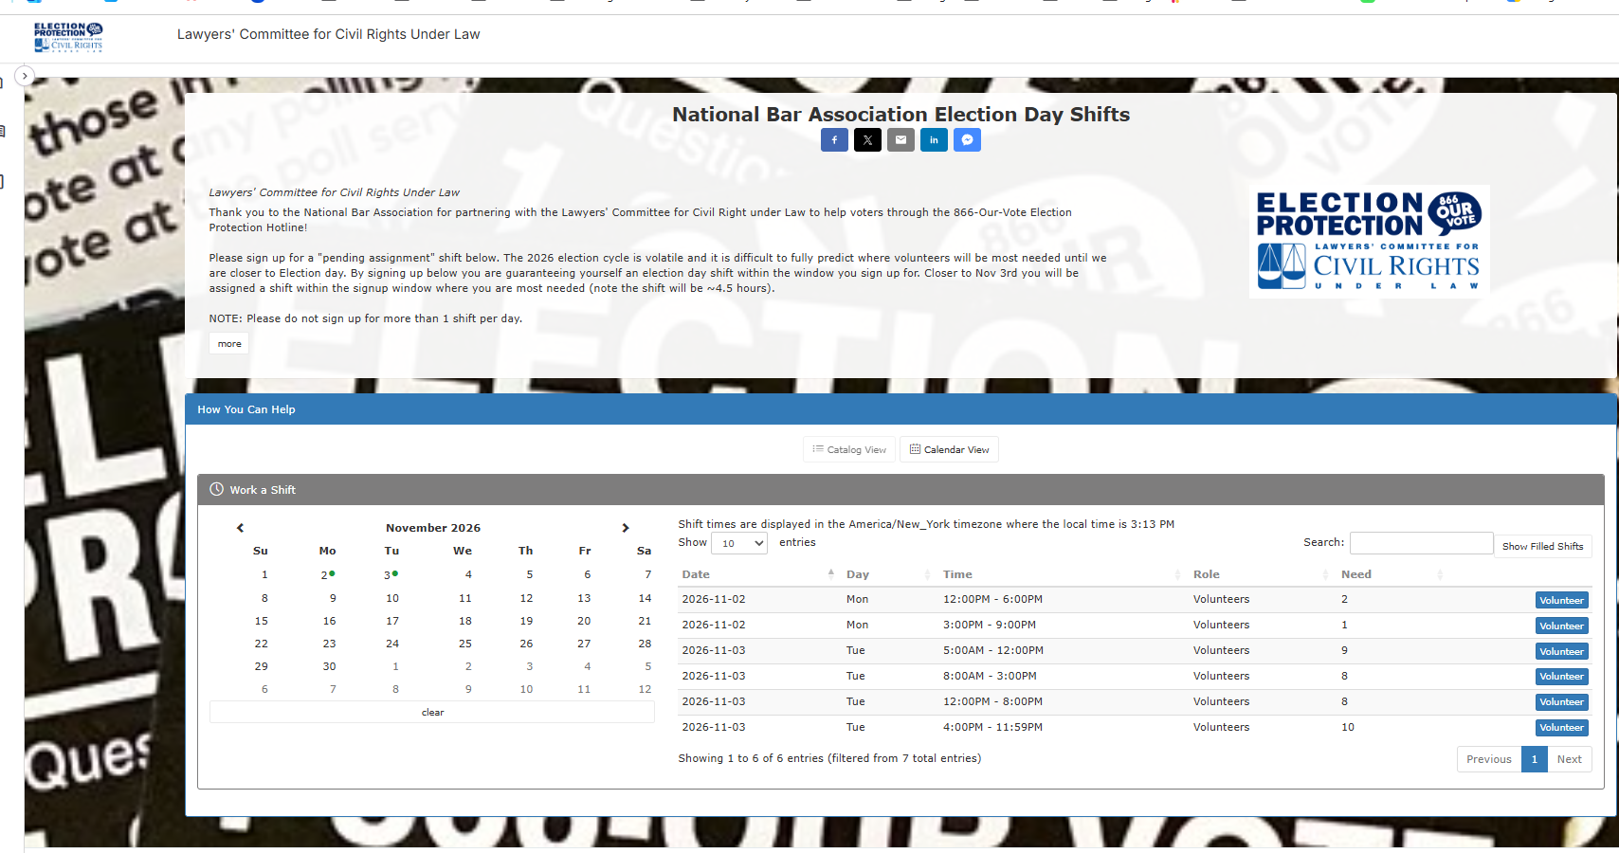
Sign up Today

Slide 7
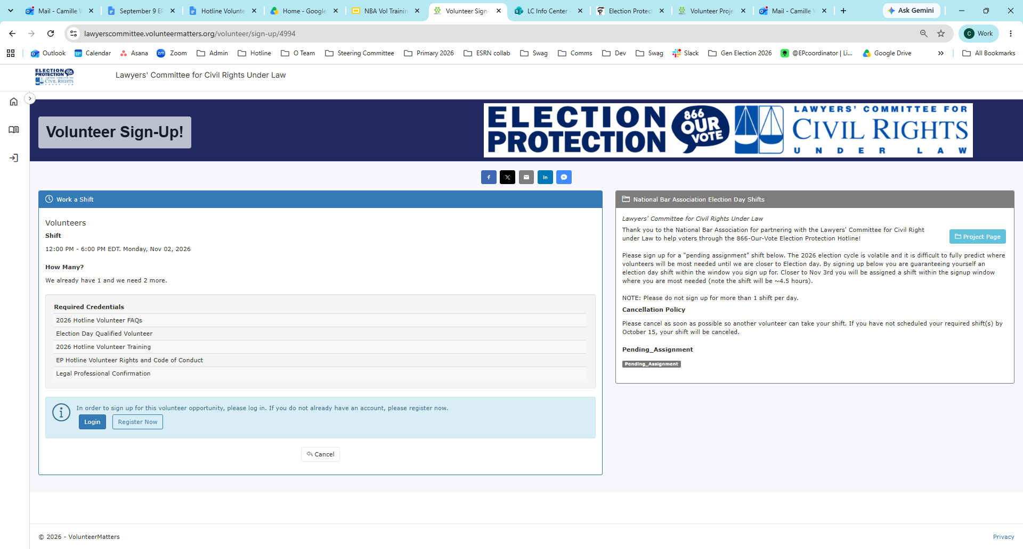
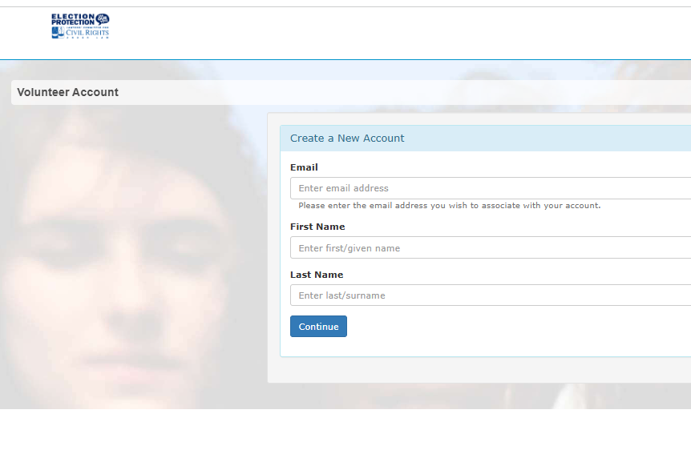
Login or & Register a New Account

Slide 8
Legal Roving Monitors
Notes:
Thank you so much for your interest in volunteering with the Election Protection Hotline, run by the Lawyers’ Committee for Civil Rights Under the Law.

Slide 9
Legal Roving Monitor Program
Purpose:
Deploy trained volunteer attorneys in strategically selected jurisdictions to provide rapid legal response, identify voting access barriers, and assess polling place accessibility (varies state by state).
The LRM Model
Trained volunteer attorneys in the field
Direct connection to the 866-OUR-VOTE hotline
Coordination with state Election Protection Command Centers
Rapid escalation of urgent legal and voter access issues
Focus on accessible, equitable voting for all voters
Notes:
The Legal Roving Monitor Program is designed to extend Election Protection's legal response capacity directly into communities. Rather than relying exclusively on stationary poll monitors, we place trained attorneys in the field who can observe what's happening at various polling locations, identify emerging issues, and help ensure those issues are reported and addressed quickly.
The goal of today's discussion is to make sure everyone understands the operating model, the timeline, and—most importantly—the respective responsibilities of the Lawyers' Committee and our NUL/NBA partners.

Slide 10
LRM Election Day Priorities
Observe & Report
Voting access barriers
Polling place accessibility
Voter intimidation or interference
Election administration issues
Legal questions requiring immediate attention
Emerging patterns across polling locations
Notes:
Observe and report!

Slide 11
How the Partnership Works
A Coordinated Legal Response Network
Lawyers' Committee / Election Protection
National program management
Program Lead onboarding
State-based recruitment and training support
Legal and operational guidance
Materials and logistics coordination
Command Center coordination
Escalation and issue response
NUL/NBA + Local Program Leads
Local volunteer recruitment
Volunteer vetting and engagement
Local deployment planning
Volunteer communications
Election Day coordination
Field-level issue identification and escalation
Shared Goal
Recruit → Train → Deploy → Report → Escalate → Resolve
Notes:
Let’s discuss our roles and responsibilities . The Lawyers' Committee will provide the infrastructure, legal framework, training, and Election Protection coordination.
NUL/NBA and designated local Program Leads will provide the local capacity necessary to recruit, organize, communicate with, and support volunteers.
The distinction is important: Program Leads should not feel like they are operating independently, but they should have clear ownership of local implementation. The Lawyers' Committee remains the central support and escalation resource.

Slide 12
What Success Looks Like
By Election Day, Every Participating Jurisdiction Should Have:
People
Fully vetted volunteer attorneys
Trained Legal Roving Monitors
Designated Program Lead
Coverage
Polling locations mapped
Volunteer shifts assigned
Geographic gaps identified
Infrastructure
Communication channels established
Command Center connection confirmed
Escalation protocols understood
Response
Issues reported quickly
Legal concerns escalated appropriately
Accessibility concerns documented
Emerging patterns identified
Volunteers supported throughout the day
Prepared Locally. Connected Statewide. Supported Nationally.
Notes:
Success is not simply the number of attorneys recruited.
A successful program means we have trained volunteers in the right places, clear communication channels, defined escalation procedures, and the ability to identify patterns across jurisdictions.
We should be able to look at the program on Election Day and know where our volunteers are, what they are seeing, what issues are emerging, and where additional support may be needed.

Slide 13
Sign up
Volunteer on Election Day as a Legal Monitor
Opportunities available in AL, GA, FL, PA, VA, and TX. NC and OH coming soon. Sign up on NBA website.
Have more time?
Serve as a program lead to help expand our legal roving monitor programming. States may include IL, LA, MI, and WI.
Email electionprotection@nationalbar.org to express interest.
Notes:
Observe and report!

